Slide 1

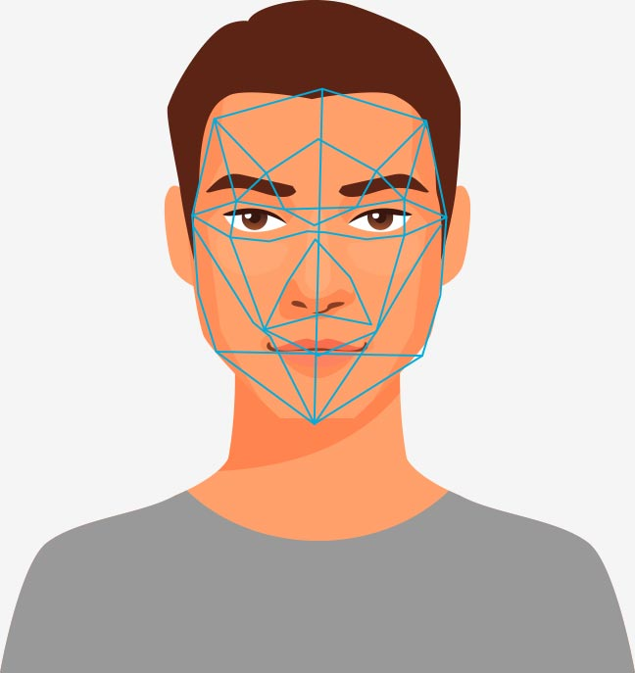
Face Recognition Attendance System
Presented By:-
-Amisha Pupala
-Pratiksha Kharatkar
-Mokshada Godase
-Pratiksha Batwal

Slide 2
INTRODUCTION
Face Recognition as it is often referred to as, analyses characteristics of a person's face image input through a camera.
Maintaining the attendance is very important in all the institutes for checking the performance of employees. Every institute has its own method in this regard.
Some are taking attendance manually using the old paper or file based approach and some have adopted methods of automatic attendance using some biometric techniques. But in these methods employees have to wait for long time in making a queue at time they enter the office.
Biometric recognition has the potential to become an irreplaceable part of many identification systems used for evaluating the performance of those people working within the organization.

Slide 3
BIOMETRICS:
Biometrics is the automated recognition of individuals based on their Behavioral or Physiological characteristics .The physiological characteristics are related to the shape of the body. . The behavioral characteristics are related to the behavior of a person
TYPES:
Physiological Characteristics
Behavioral Characteristics
For an organization to be effective, it needs accurate and fast means of recording the performance of the people inside this organization.
Biometric recognition has the potential to become an irreplaceable part of many identification systems used for evaluating the performance of those people working within the organization

Slide 4
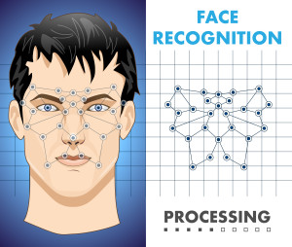
FACIAL RECOGNITION
Facial recognition (or face recognition) is a biometric method of identifying an individual by comparing live capture or digital image data with the stored record for that person.
Most current facial recognition systems work with numeric codes called face prints. Such systems identify 80 nodal points on a human face.
Facial recognition systems
based on face prints can
quickly and accurately identify
target individuals when the
conditions are favourable.

Slide 5
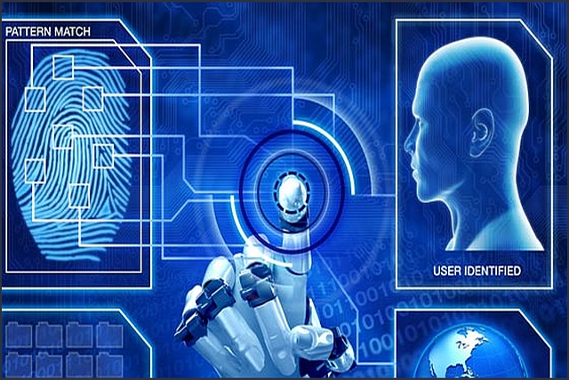
Techniques for feature extraction
Graph matching
Template matching
Neural Networks
Deep learning
3D based

Slide 6
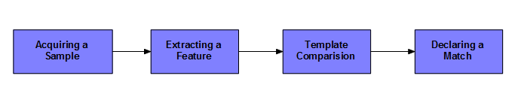
There are four steps in face recognition process:
Acquiring a sample
Extracting Features
Comparison Templates
Declaring a Match

Slide 7

CURRENT SYSTEM
Taking attendance manually is a lengthy process and takes a lot of time and effort, especially if it is a lecture with a huge number of students.
Moreover the attendance sheet is subjected to damage and loss while being passed on between different students or teaching staff.
Also dealing with the records of a large number of students often leads to human errors.

Slide 8

PROPOSED SYSTEM
The Proposed system overcomes the problem of the existing system. This project uses the face recognition technique using this student record the attendance.

Slide 9

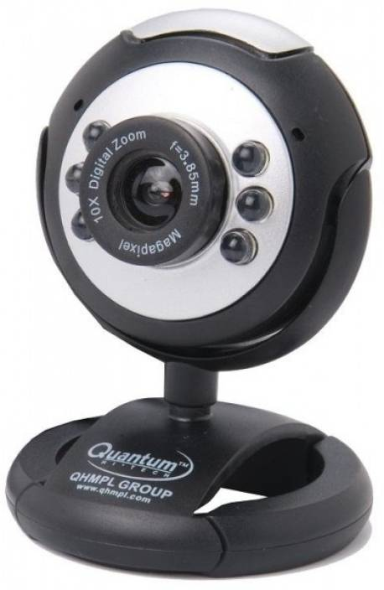
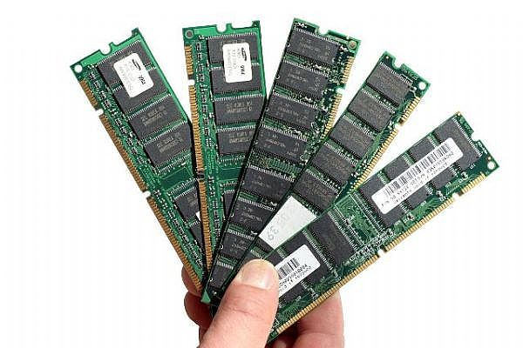
REQUIREMENT ANALYSIS
Hardware Requirements
Processing: 1.66 GHz Pentium Processor or Intel compatible processor.
Memory: 2GB RAM
80 GB free Hard Disk space
Web camera of Resolution: 512 by 512 pixels.
Software
Visual Studio 2010(.Net framework)
My SQL Server 2008

Slide 10
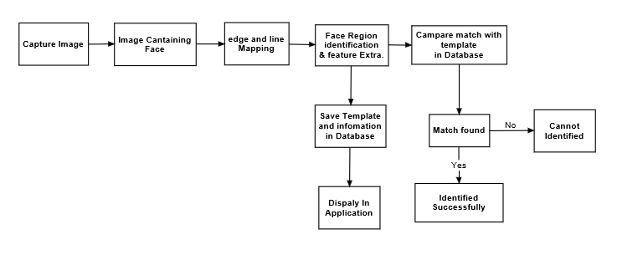
BLOCK DIAGRAM

Slide 11
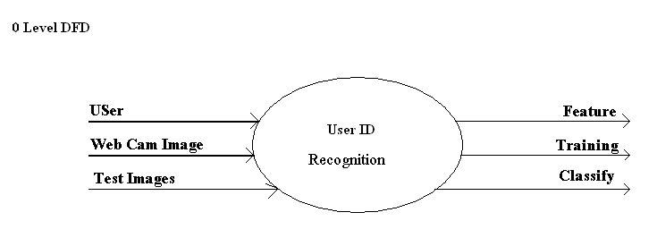
DATA FLOW DIAGRAM
LEVEL 0 DFD

Slide 12
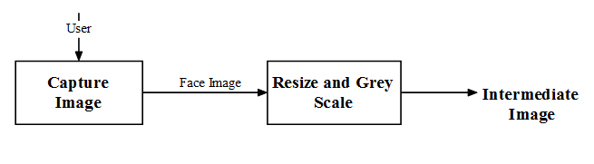
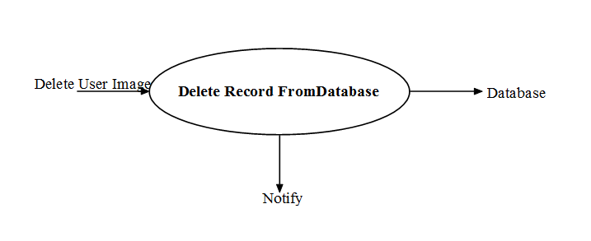
Level 2 DFD

Slide 13
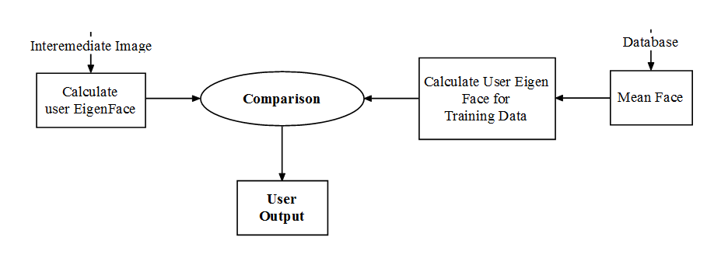
Level 2 DFD

Slide 14
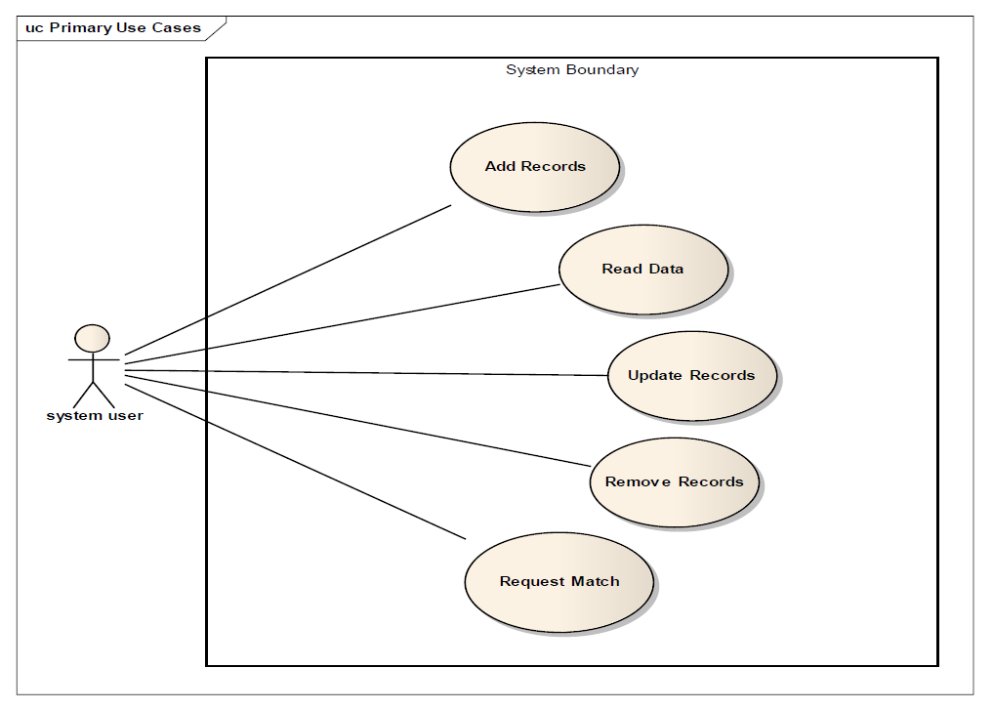
UML DIAGRAM

Slide 15

WORKING OF THE PROJECT

Slide 16
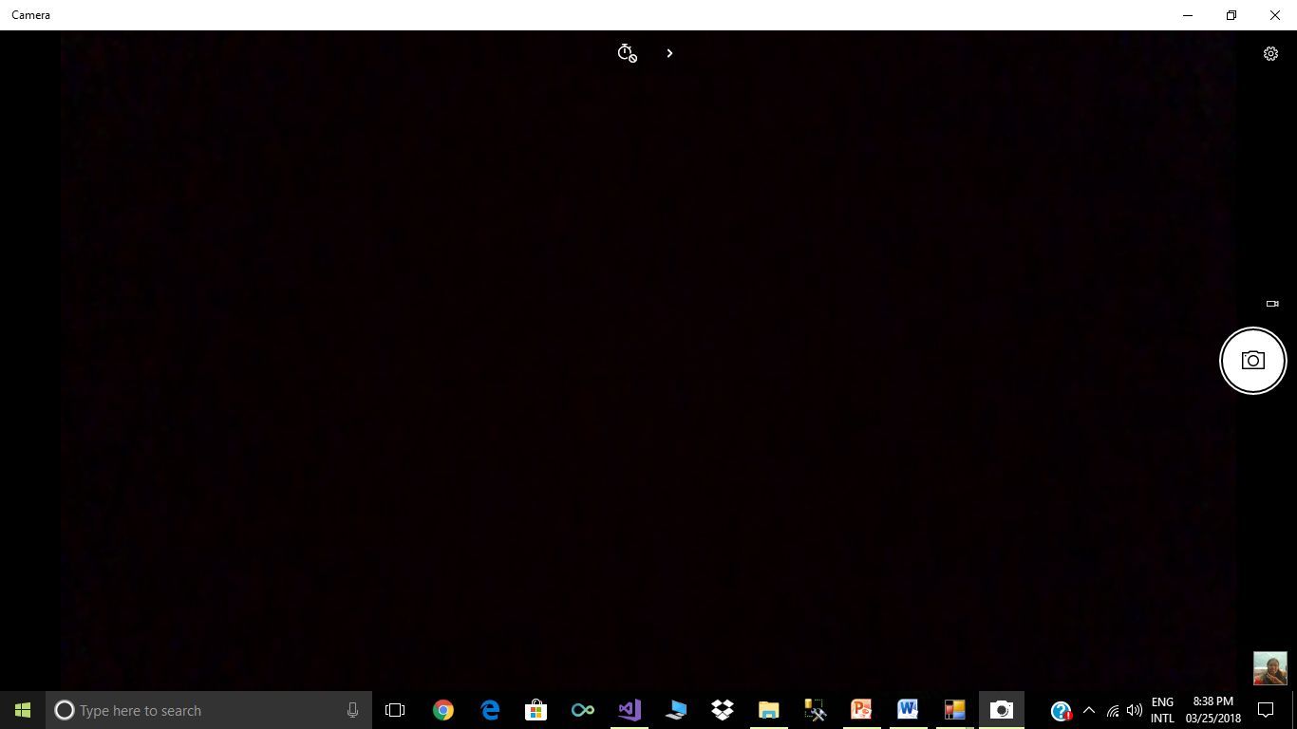
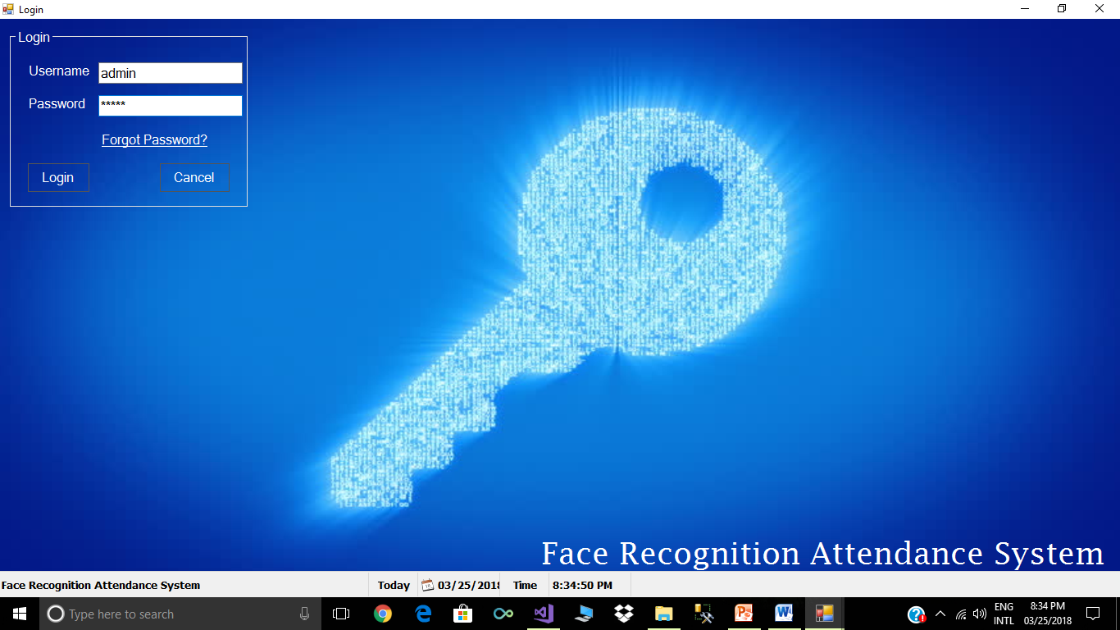

Slide 17
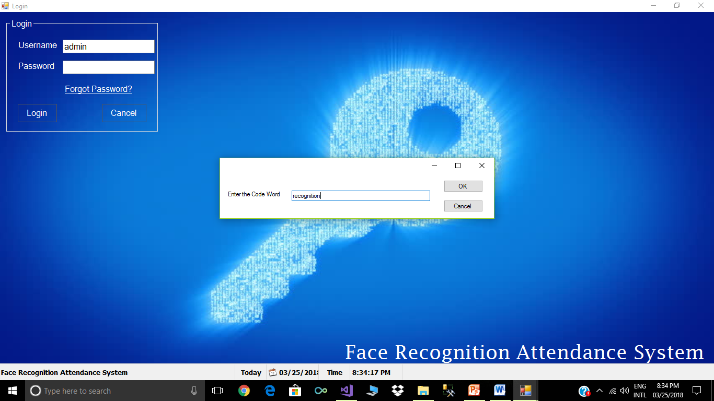

Slide 18
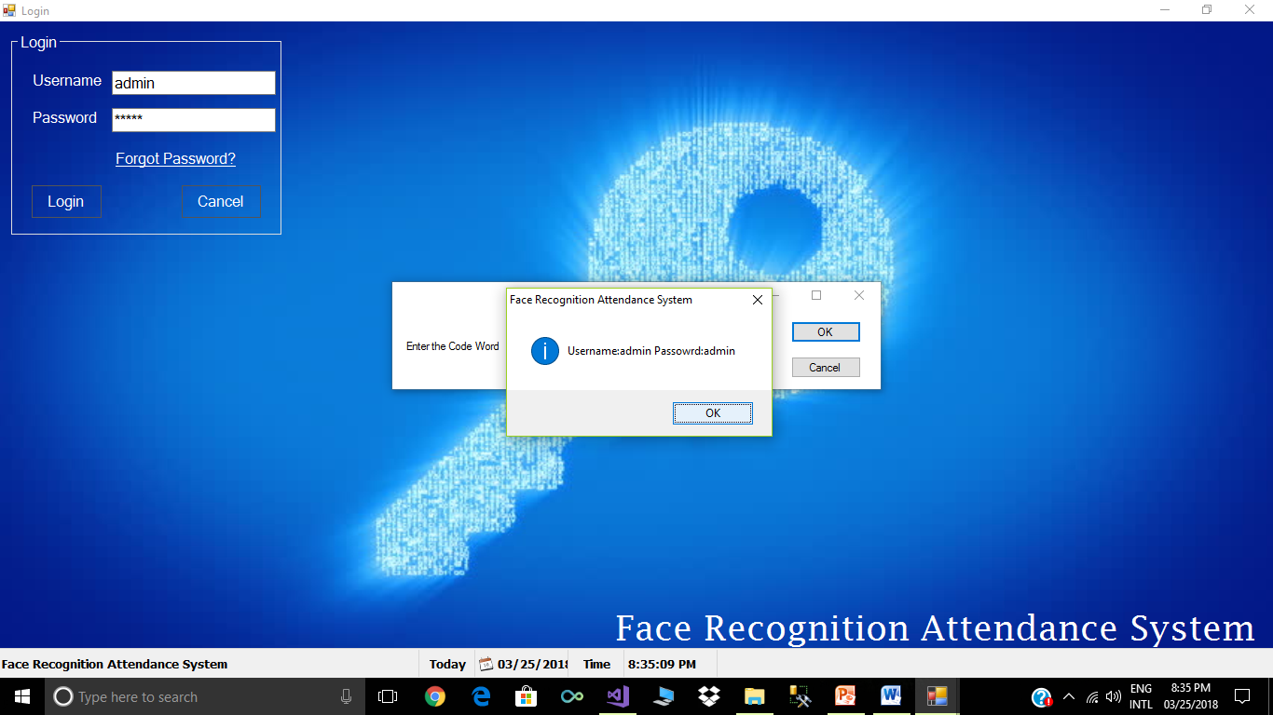

Slide 19
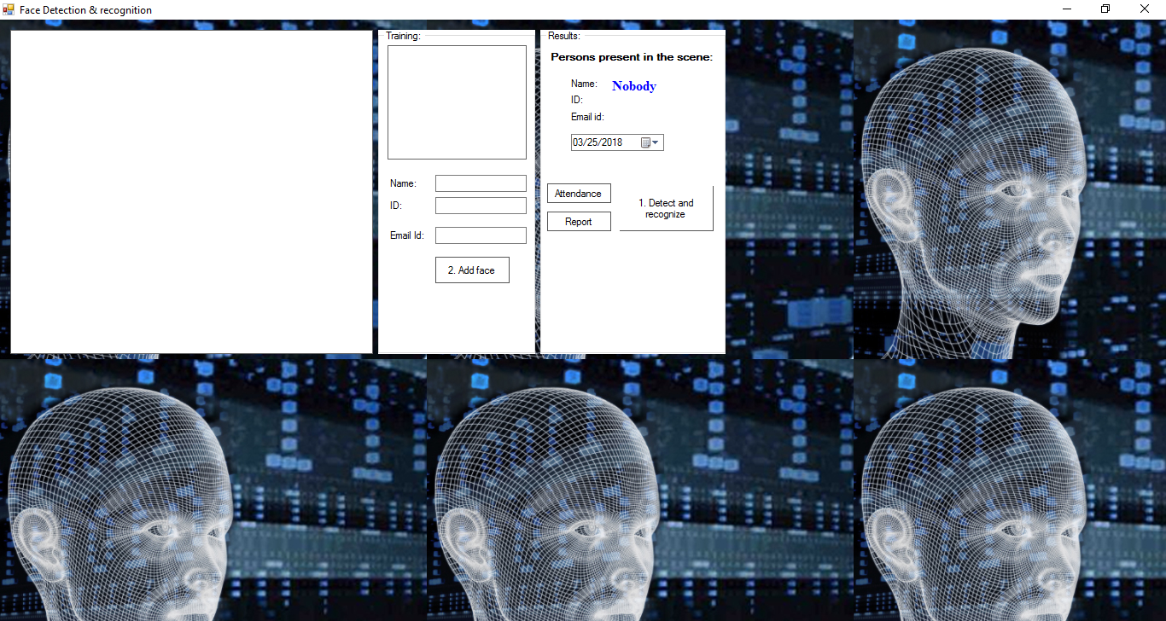

Slide 20
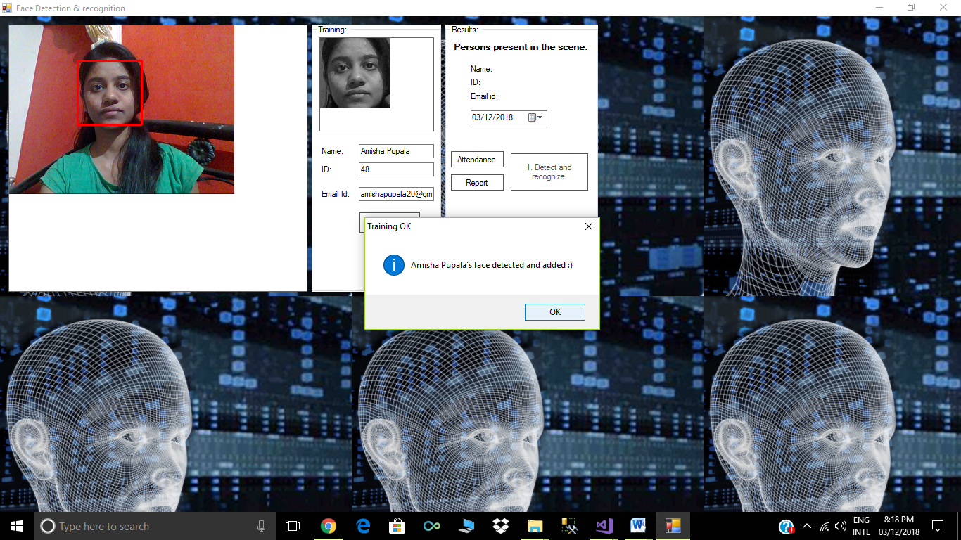

Slide 22
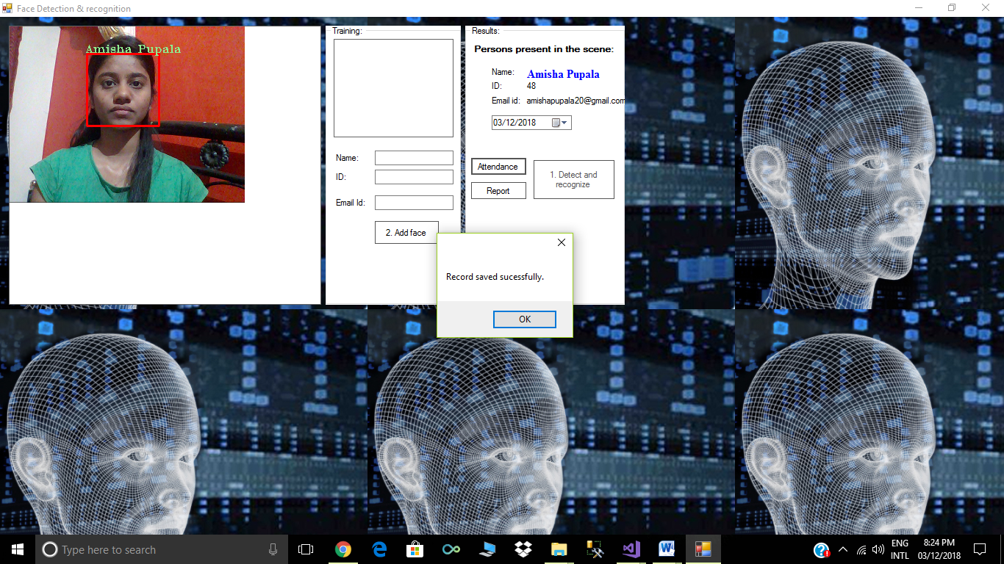

Slide 23
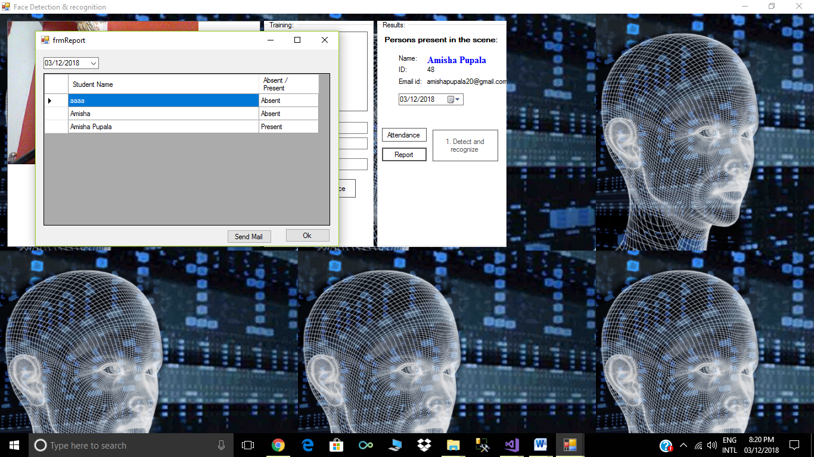

Slide 24
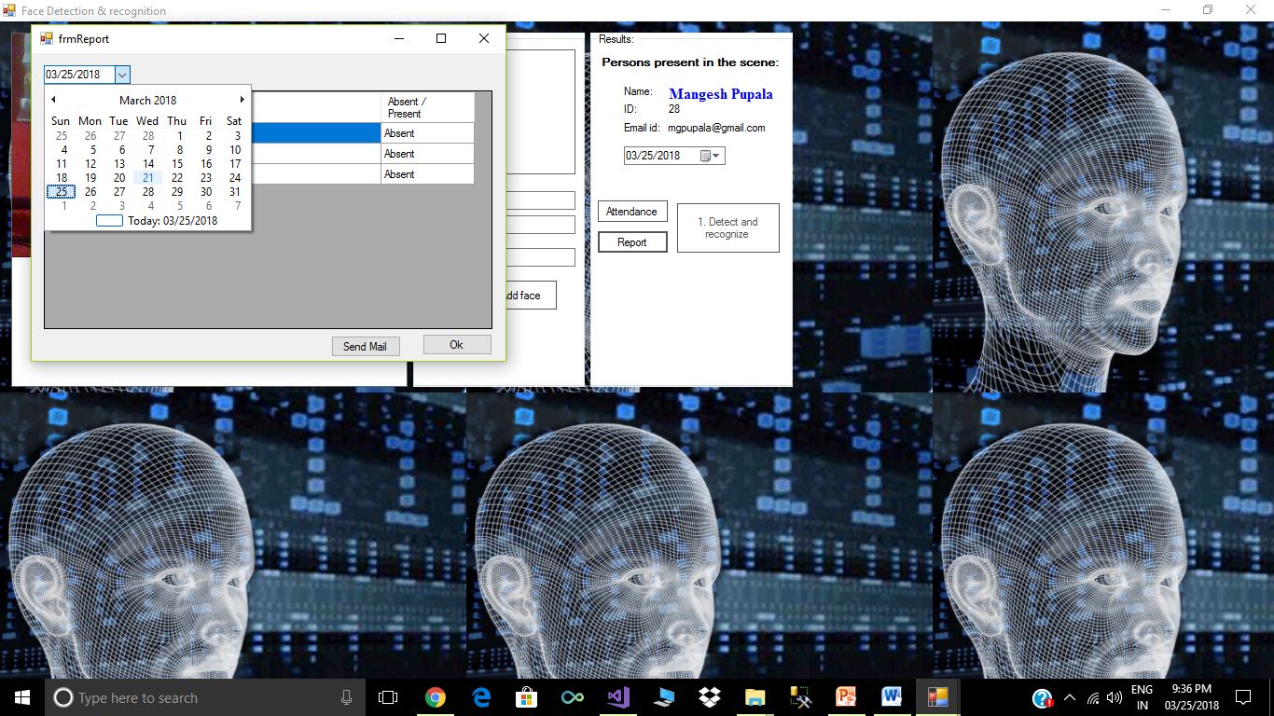

Slide 25
FUTURE SCOPE
The system we have developed has successfully able to accomplish the task of making the attendance in the classroom automatically and output obtained in an excel sheet as desired in real time.
Another important aspect where we can work is towards creating an online data base of the attendance and its automatic updating, keeping in mind growing popularity of internet of things.
The scope of the project is the system on which the software is installed, i.e. the project is developed as a desktop application, and it will work for a particular institute. But later on the project can be modified to operate it online.

Slide 26

MERITS
Improved security
Improved customer experience
Cannot be forgotten or lost
Reduced operational costs
DEMERITS
Environment and usage can affect measurements
Systems are not 100% accurate.
Require integration and/or
additional hardware

Slide 27
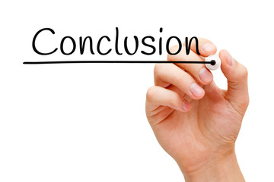
It can be concluded from the above dialogue that a dependable, secure ,rapid and an efficient system has been evolved changing a guide and an unreliable system .This process can be carried out for higher outcomes regarding the control of attendance .this system will keep time ,reduce the quantity of work the administration has to do and will update stationary material with digital apparatus .Every other application of this machine is that it is capable of marking the presence of personnel at any place of work and this attendance will be useful for calculating their month to month payment.

Slide 28


